Slide 1
Aspen Simulation of Staged Separation Unit-Ops: Distillation
Paige, Morgan, Rohan, Shakti, and Jake

Slide 2
Introduction
Used to simulate separation of a mixture into component rich streams
Generally done using a RADFRAC block
Contains an input feed stream and output distillate and bottoms streams
Condenser at the top and reboiler at the bottom of the column
Possible specifications include:
Number of stages
Condenser / Reboiler type
Distillate rate
Reflux ratio
Feed stage

Slide 3
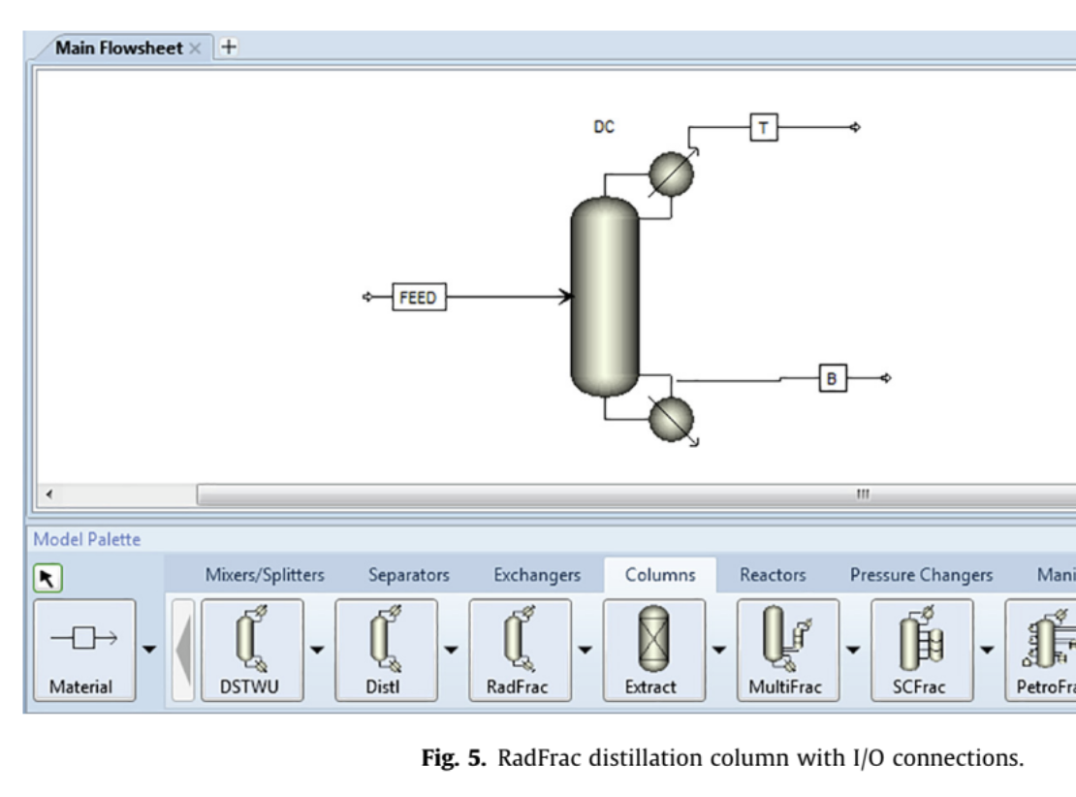
Current Research
Study: Simulation study of distillation column using Aspen Plus
Study Details:
Mixture: 30% IPA / 70% Water
RadFrac column at 27°C, 1 bar
Variables:
Number of stages, reflux ratio, distillate rate, column geometry, pressures, temperatures, vapor fractions
Yadav, E. S.; Indiran, T.; Nayak, D.; Kumar, C. H. A.; Selvakumar, M. Simulation Study of Distillation Column Using Aspen Plus. Mater. Today Proc. 2022, 48 (Part 2), 330–337. https://doi.org/10.1016/j.matpr.2020.07.609.
Figure 1. Yadav, E. S.; Indiran, T.; Nayak, D.; Kumar, C. H. A.; Selvakumar, M. Simulation Study of Distillation Column Using Aspen Plus. Mater. Today Proc. 2022, 48 (Part 2), 330–337. https://doi.org/10.1016/j.matpr.2020.07.609.
Notes:
Separating liquid mixture into two or more components
Phenomena of evaporation and condensation by means of relative volatility difference
The research in this article specifies the theory behind ASPEN.
ASPEN is useful for process simulation and optimization with a high degree of accuracy. It utilizes large number of databanks and has a variety of packages, including ASPEN Plus and ASPEN HYSYS, which allows for simulation of a wide range of processes.
The degree of freedom is the number of variables of the system minus the number of independent variables. For a DOF of zero, the design problem is solvable. If the DOF is greater than 0, the problem is underspecified. If it is less than 0, the problem is over specified.
This study evaluated distillation of isopropyl alcohol and water in a ratio of 30% and 70% using a RadFrac column with a feed temperature of 27 degrees celsius at 1 bar. The number of stages, reflux ratio, distillate rate, column geometry, pressures, temperatures, and vapor fractions were all specified.
The paper presents equilibrium diagrams like the Txy plot, Pxy plot, and activity coefficient plot which provide the relationship between mole fraction of liquid phase, vapor phase with changes in temperature, pressure, and activity coefficients, respectively.

Slide 4
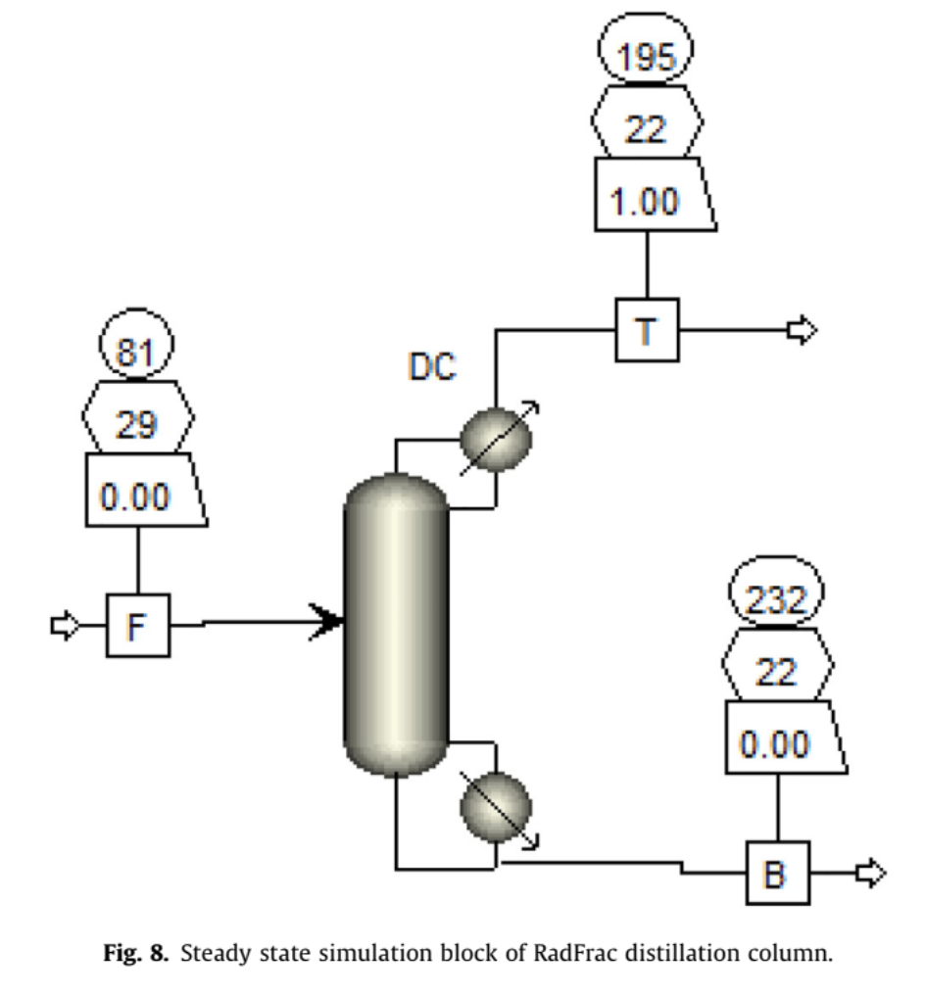
Current Research
Study: Simulation study of distillation column using Aspen Plus
Study Details:
Mixture: 30% IPA / 70% Water
RadFrac column at 27°C, 1 bar
Variables:
Number of stages, reflux ratio, distillate rate, column geometry, pressures, temperatures, vapor fractions
Yadav, E. S.; Indiran, T.; Nayak, D.; Kumar, C. H. A.; Selvakumar, M. Simulation Study of Distillation Column Using Aspen Plus. Mater. Today Proc. 2022, 48 (Part 2), 330–337. https://doi.org/10.1016/j.matpr.2020.07.609.
Figure 2. Yadav, E. S.; Indiran, T.; Nayak, D.; Kumar, C. H. A.; Selvakumar, M. Simulation Study of Distillation Column Using Aspen Plus. Mater. Today Proc. 2022, 48 (Part 2), 330–337. https://doi.org/10.1016/j.matpr.2020.07.609.
Notes:
Separating liquid mixture into two or more components
Phenomena of evaporation and condensation by means of relative volatility difference
The research in this article specifies the theory behind ASPEN.
ASPEN is useful for process simulation and optimization with a high degree of accuracy. It utilizes large number of databanks and has a variety of packages, including ASPEN Plus and ASPEN HYSYS, which allows for simulation of a wide range of processes.
The degree of freedom is the number of variables of the system minus the number of independent variables. For a DOF of zero, the design problem is solvable. If the DOF is greater than 0, the problem is underspecified. If it is less than 0, the problem is over specified.
This study evaluated distillation of isopropyl alcohol and water in a ratio of 30% and 70% using a RadFrac column with a feed temperature of 27 degrees celsius at 1 bar. The number of stages, reflux ratio, distillate rate, column geometry, pressures, temperatures, and vapor fractions were all specified.
The paper presents equilibrium diagrams like the Txy plot, Pxy plot, and activity coefficient plot which provide the relationship between mole fraction of liquid phase, vapor phase with changes in temperature, pressure, and activity coefficients, respectively.

Slide 5
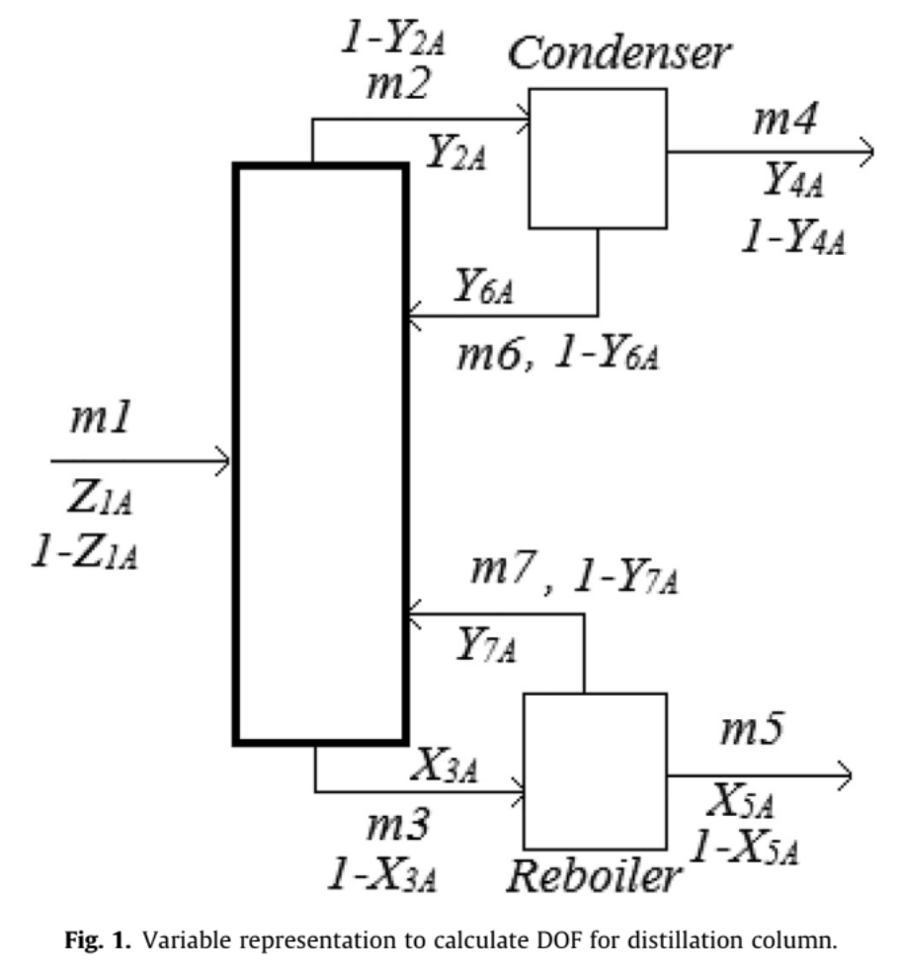
Current Research
ASPEN Software:
Used for process simulation & optimization
Utilizes large databanks & multiple packages (ASPEN Plus, ASPEN HYSYS)
Ensures high accuracy in steady state modeling
Degree of Freedom (DOF):
DOF = 0: Solvable problem
DOF > 0: Underspecified
DOF < 0: Overspecified
Figure 3. Yadav, E. S.; Indiran, T.; Nayak, D.; Kumar, C. H. A.; Selvakumar, M. Simulation Study of Distillation Column Using Aspen Plus. Mater. Today Proc. 2022, 48 (Part 2), 330–337. https://doi.org/10.1016/j.matpr.2020.07.609.
Notes:
Separating liquid mixture into two or more components
Phenomena of evaporation and condensation by means of relative volatility difference
The research in this article specifies the theory behind ASPEN.
ASPEN is useful for process simulation and optimization with a high degree of accuracy. It utilizes large number of databanks and has a variety of packages, including ASPEN Plus and ASPEN HYSYS, which allows for simulation of a wide range of processes.
The degree of freedom is the number of variables of the system minus the number of independent variables. For a DOF of zero, the design problem is solvable. If the DOF is greater than 0, the problem is underspecified. If it is less than 0, the problem is over specified.
This study evaluated distillation of isopropyl alcohol and water in a ratio of 30% and 70% using a RadFrac column with a feed temperature of 27 degrees celsius at 1 bar. The number of stages, reflux ratio, distillate rate, column geometry, pressures, temperatures, and vapor fractions were all specified.
The paper presents equilibrium diagrams like the Txy plot, Pxy plot, and activity coefficient plot which provide the relationship between mole fraction of liquid phase, vapor phase with changes in temperature, pressure, and activity coefficients, respectively.

Slide 6
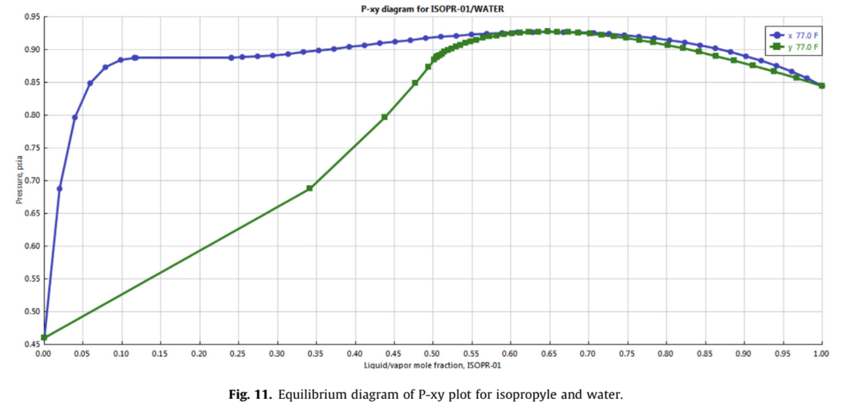
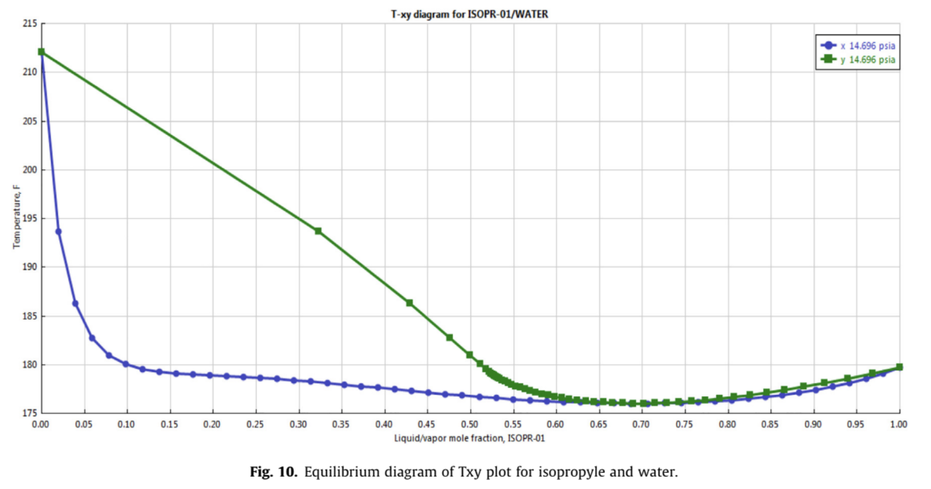
Current Research
Equilibrium Diagrams Presented:
Txy Plot: Temp vs. mole fraction
Pxy Plot: Pressure vs. mole fraction
Figure 4. Yadav, E. S.; Indiran, T.; Nayak, D.; Kumar, C. H. A.; Selvakumar, M. Simulation Study of Distillation Column Using Aspen Plus. Mater. Today Proc. 2022, 48 (Part 2), 330–337. https://doi.org/10.1016/j.matpr.2020.07.609.
Figure 5. Yadav, E. S.; Indiran, T.; Nayak, D.; Kumar, C. H. A.; Selvakumar, M. Simulation Study of Distillation Column Using Aspen Plus. Mater. Today Proc. 2022, 48 (Part 2), 330–337. https://doi.org/10.1016/j.matpr.2020.07.609.
Notes:
Separating liquid mixture into two or more components
Phenomena of evaporation and condensation by means of relative volatility difference
The research in this article specifies the theory behind ASPEN.
ASPEN is useful for process simulation and optimization with a high degree of accuracy. It utilizes large number of databanks and has a variety of packages, including ASPEN Plus and ASPEN HYSYS, which allows for simulation of a wide range of processes.
The degree of freedom is the number of variables of the system minus the number of independent variables. For a DOF of zero, the design problem is solvable. If the DOF is greater than 0, the problem is underspecified. If it is less than 0, the problem is over specified.
This study evaluated distillation of isopropyl alcohol and water in a ratio of 30% and 70% using a RadFrac column with a feed temperature of 27 degrees celsius at 1 bar. The number of stages, reflux ratio, distillate rate, column geometry, pressures, temperatures, and vapor fractions were all specified.
The paper presents equilibrium diagrams like the Txy plot, Pxy plot, and activity coefficient plot which provide the relationship between mole fraction of liquid phase, vapor phase with changes in temperature, pressure, and activity coefficients, respectively.

Slide 7
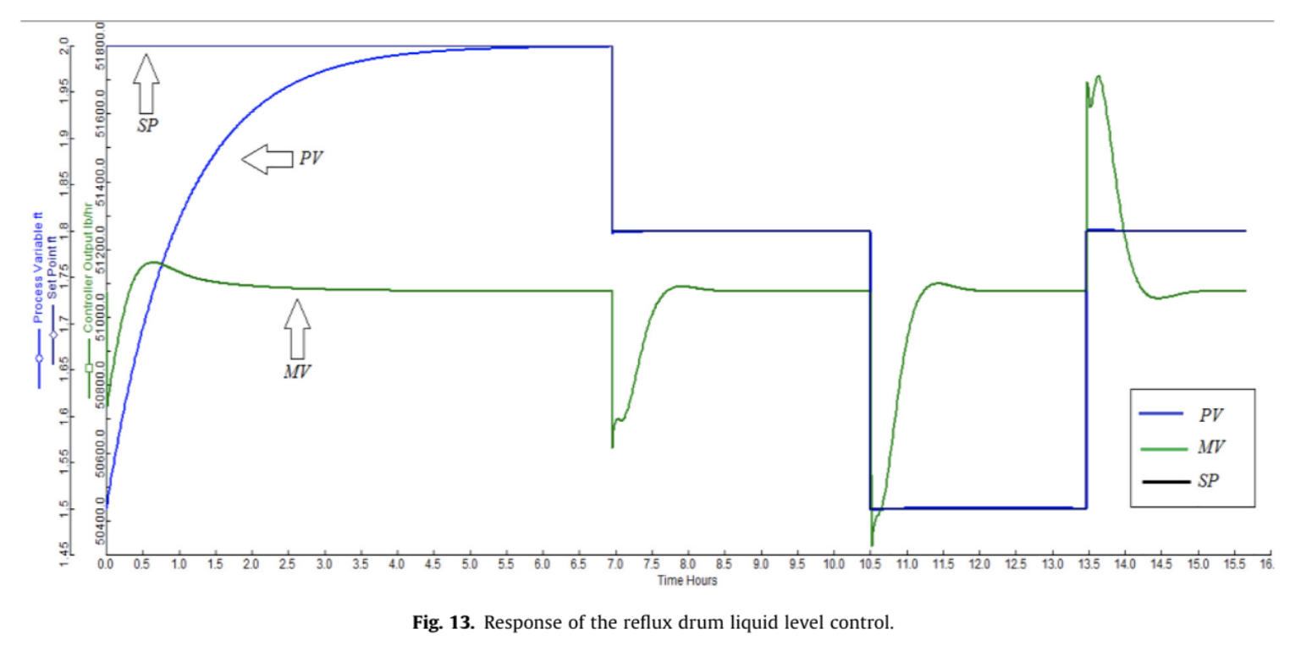
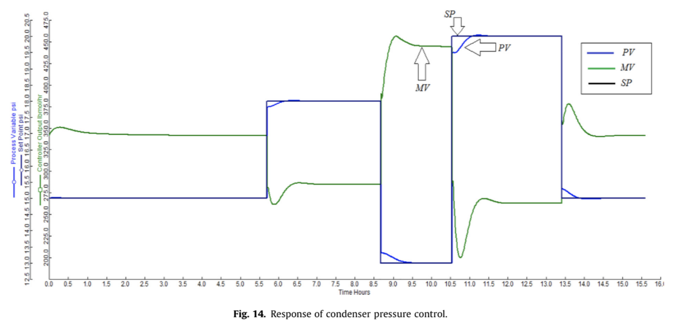
Current Research
Equilibrium Diagrams Presented:
Response of the reflux drum liquid level control
Response of condenser pressure control
Figure 6. Yadav, E. S.; Indiran, T.; Nayak, D.; Kumar, C. H. A.; Selvakumar, M. Simulation Study of Distillation Column Using Aspen Plus. Mater. Today Proc. 2022, 48 (Part 2), 330–337. https://doi.org/10.1016/j.matpr.2020.07.609.
Figure 7. Yadav, E. S.; Indiran, T.; Nayak, D.; Kumar, C. H. A.; Selvakumar, M. Simulation Study of Distillation Column Using Aspen Plus. Mater. Today Proc. 2022, 48 (Part 2), 330–337. https://doi.org/10.1016/j.matpr.2020.07.609.
Notes:
Separating liquid mixture into two or more components
Phenomena of evaporation and condensation by means of relative volatility difference
The research in this article specifies the theory behind ASPEN.
ASPEN is useful for process simulation and optimization with a high degree of accuracy. It utilizes large number of databanks and has a variety of packages, including ASPEN Plus and ASPEN HYSYS, which allows for simulation of a wide range of processes.
The degree of freedom is the number of variables of the system minus the number of independent variables. For a DOF of zero, the design problem is solvable. If the DOF is greater than 0, the problem is underspecified. If it is less than 0, the problem is over specified.
This study evaluated distillation of isopropyl alcohol and water in a ratio of 30% and 70% using a RadFrac column with a feed temperature of 27 degrees celsius at 1 bar. The number of stages, reflux ratio, distillate rate, column geometry, pressures, temperatures, and vapor fractions were all specified.
The paper presents equilibrium diagrams like the Txy plot, Pxy plot, and activity coefficient plot which provide the relationship between mole fraction of liquid phase, vapor phase with changes in temperature, pressure, and activity coefficients, respectively.

Slide 8
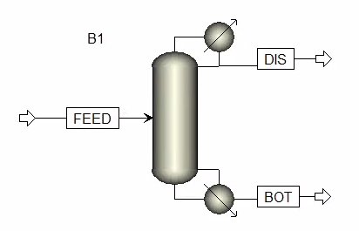
Aspen Example Introduction
Hydrocarbon distillation is a common separation technique used in chemical processing
RadFrac column set up with the following feed parameters:
n-Butane 33% (LK)
Isobutane 15%
n-Pentane 15%
Propane 12%
Isopentane 25% (HK)
360K, 8.14 atm, 14 stages

Slide 9
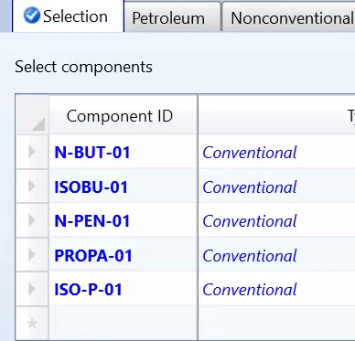
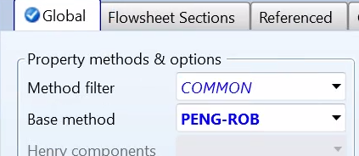
Aspen Set Up

Slide 10
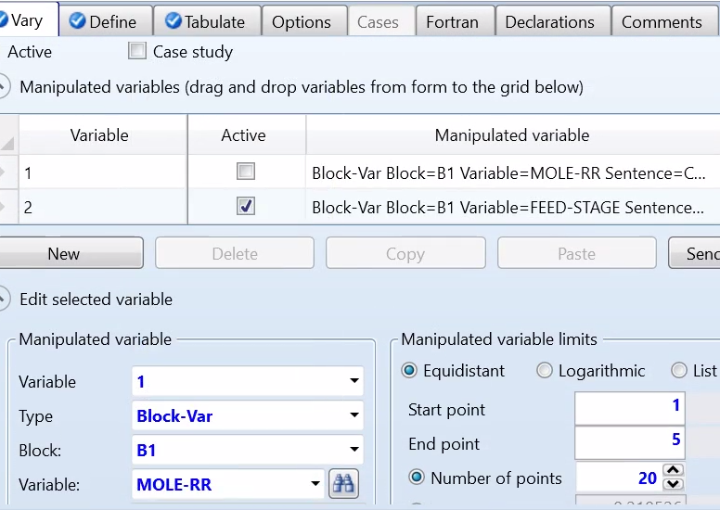
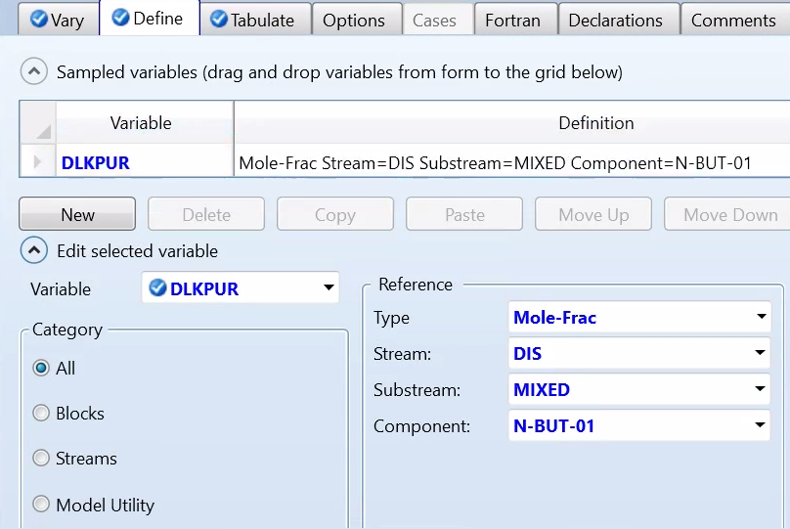
Sensitivity Analysis

Slide 11
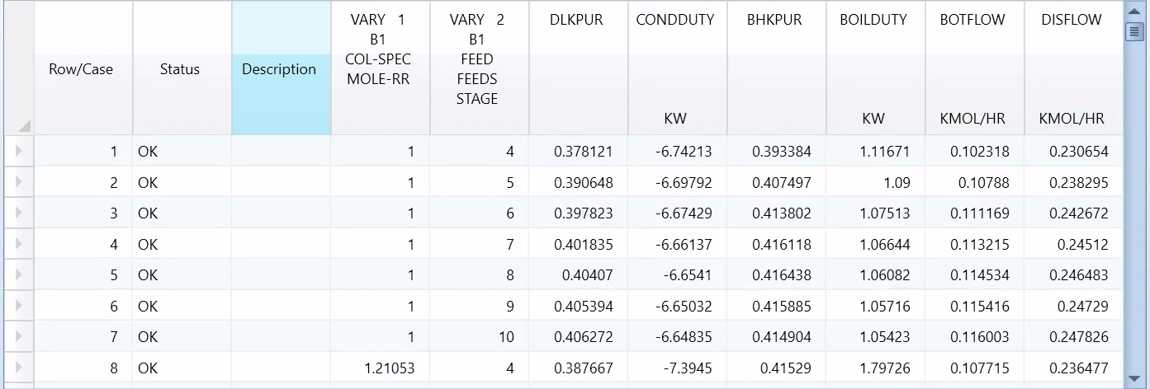
Tabulated Results

Slide 12
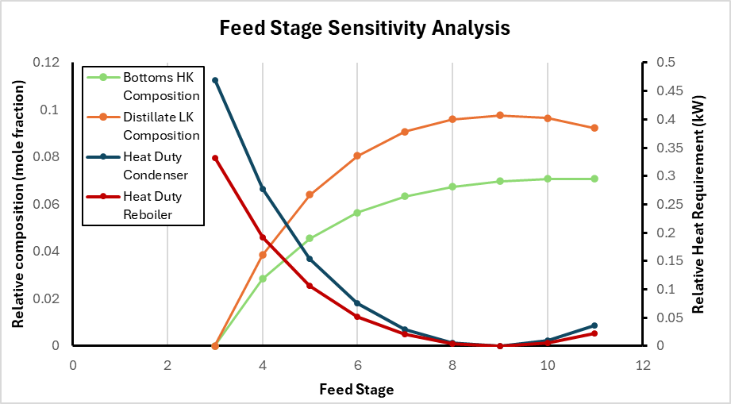
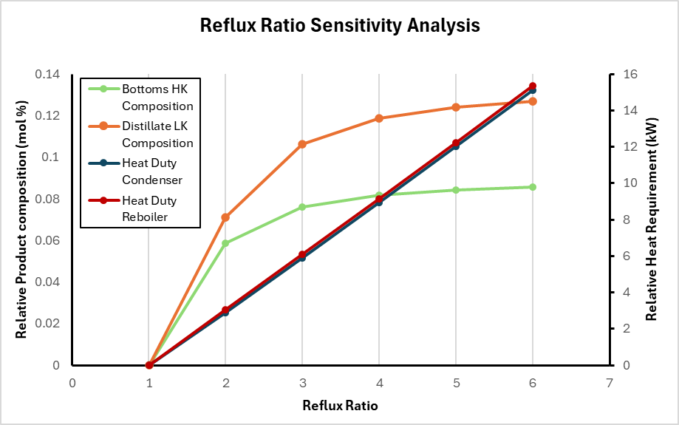
Aspen File Outputs
Sensitivity analysis done on distillation column to see the effect of feed stage and reflux ratio
The following optimum are determined for minimizing energy/maximizing purity:
Feed stage optimum at 9 stages above the first stage
Optimum reflux around 3

Slide 13
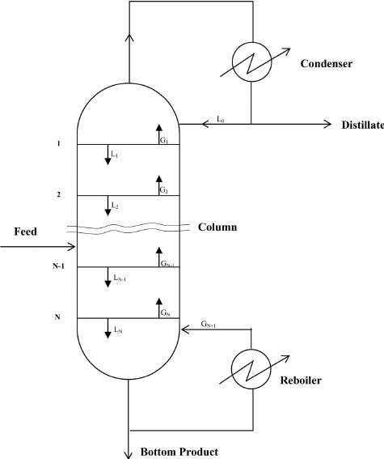
Analysis: Connecting Aspen to the Theory (CHBE 426)
Feed Stage
Ideally low
Additional stages = Additional funds
Middle Stage
Greatest Efficiency For Space
Reflux Ratio (Lc/D)
High Ratio
Higher Purity Distillate, More Reflux
Low Ratio
Lower Purity Distillate, More Distillate
Figure 8. Exergy analysis of binary plate distillation column operations. Scientific Figure on ResearchGate. Available at: https://www.researchgate.net/figure/A-simple-distillation-unit_fig1_245402461

Slide 14
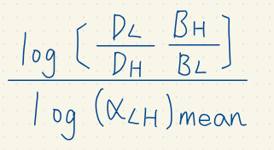
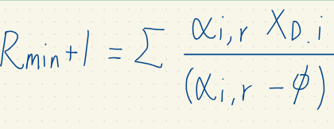
Analysis: How Does Our Simulation Compare (CHBE 426)
Ours
Feed Stage
9
Optimum Reflux
3
Theory
Feed Stage
9
Optimum Reflux
2.8
Vacuum Distillation- Environmental Chemistry Branch | US EPA. archive.epa.gov. https://archive.epa.gov/esd/archive-vacuum/web/html/table1.html.
CHBE 426: Separations, Po Yen-Chen; [University of Maryland], [College Park, MD], 2024.

Slide 15
Analysis: Trends

Slide 16
Summary
Aspen can be used for the modeling of distillation columns in ideal and non-ideal scenarios
Accurately shows the variation in results when initial and operating conditions are changed
Allows for the modeling of multiple distillation columns of various types in one simulation for the separation of multiple components
Output results allow for the optimization of real-life distillation columns in a virtual and inexpensive manner

Slide 17
Thank you!

Slide 18
Sources
Yadav, E. S.; Indiran, T.; Nayak, D.; Kumar, C. H. A.; Selvakumar, M. Simulation Study of Distillation Column Using Aspen Plus. Mater. Today Proc. 2022, 48 (Part 2), 330–337. https://doi.org/10.1016/j.matpr.2020.07.609.
Vacuum Distillation- Environmental Chemistry Branch | US EPA. archive.epa.gov. https://archive.epa.gov/esd/archive-vacuum/web/html/table1.html.
CHBE 426: Separations, Po Yen-Chen; [University of Maryland], [College Park, MD], 2024.
Exergy analysis of binary plate distillation column operations. Scientific Figure on ResearchGate. Available at: https://www.researchgate.net/figure/A-simple-distillation-unit_fig1_245402461
‌

